Slide 1

Basketball Players Performance Analytic as Experiential Learning Approach in Teaching Undergraduate Data Science Course
By
-Nurfadhlina Mohd Sharef - Muhammad bin Nor Azmi
-Aida Mustapha - Rosdiadee Nordin
PRIYAL BABEL
1911041

Slide 2
INTRODUCTION
There has been rapid growth in sports analytic.
Benefits of data analytics in basketball:
Predict game result or outcomes.
Evaluate player’s performance.
Provides solution for supporting the basketball coaches in making decisions.

Slide 3
Steps in Data Analytic
Data Retrieval
Data pre-processing
Exploratory data analysis
Machine learning models development, evaluation and testing
Visualization and communication

Slide 4
Choice of Machine Learning model
Depends on the goal and characteristic of the analytic.
For example,
For descriptive analytic
Apriori and k-means algorithms
For predictive analytic
Decision Tree, Random Forest and Regression algorithms

Slide 5
Experiential Learning implementation
Expected outcome of project:
Understanding data mining tasks based on a focused domain scenario.
Developing skills for exploring, analyzing, visualizing data by applying suitable tools.
Planning and managing data mining projects by utilizing elevator pitch technique, and project reporting through an online blog.
Developing teamwork skills through management, development, implementation, and reporting of the project

Slide 6
Basketball Players Performance Analytic
Expectations of the analytic:
Set of players that is either offensive of defensive-oriented.
Prediction/probability of winning/losing based on a different set of players
Association rules on winning or losing
Clustering players based on their strengths or weaknesses

Slide 7
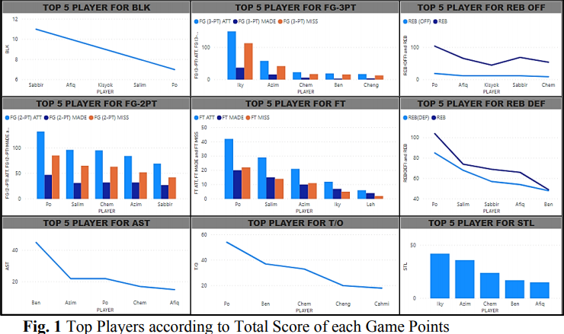
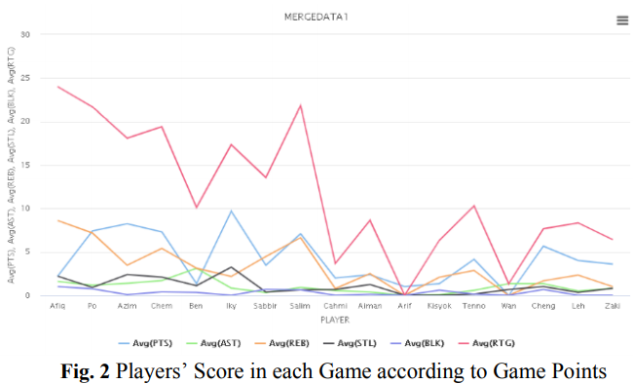
Exploratory Basketball Games Data Analysis

Slide 8
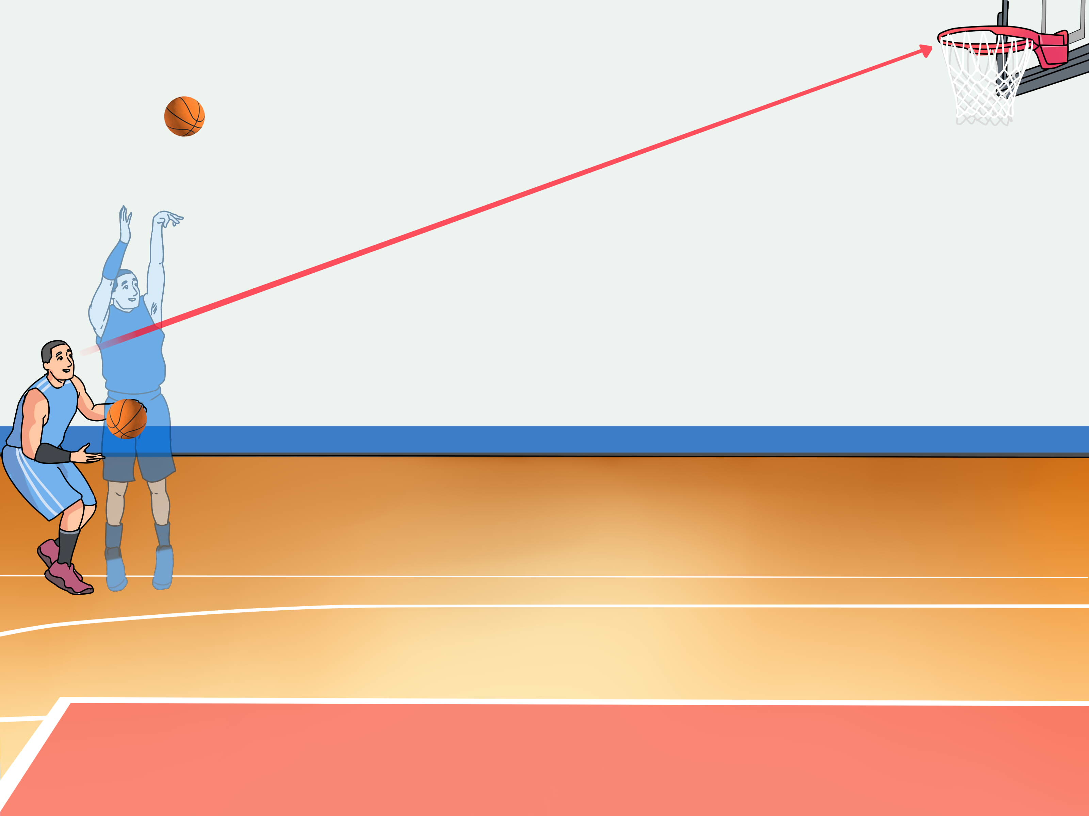
Machine Learning Models Development
Two data mining methodologies have been used:
Clustering
3- and 2-point shooting analysis
Attack profiling analysis
Team performance analysis.
Classification
Game match outcome
Player rating or performance prediction.

Slide 9
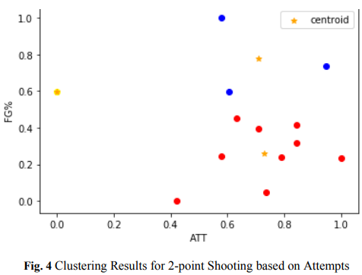
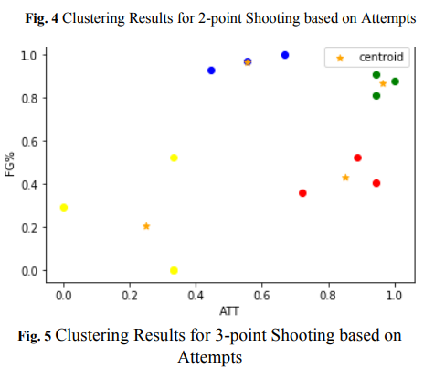
Shooting Performance Analysis

Slide 10
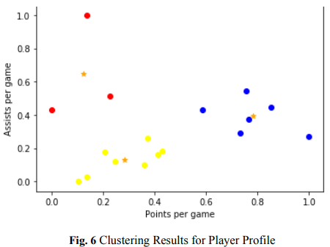
Attack Profiling Analysis
Types of players
Offensive
Defensive
K-Means algorithm is used to perform the analysis

Slide 11
K-Means Analysis
To process the learning data, the K-means algorithm in data mining starts with a first group of randomly selected centroids, which are used as the beginning points for every cluster, and then performs iterative (repetitive) calculations to optimize the positions of the centroids
It halts creating and optimizing clusters when either:
The centroids have stabilized — there is no change in their values because the clustering has been successful.
The defined number of iterations has been achieved.

Slide 12
Team Performance Analysis
Conducted via a clustering experiment using the k-Means algorithm
Class 0 belongs to the weaker player of the team.
Class 1 belongs to the team’s top players.
Class 2 belongs to the team’s modest personnel.
Class 3 belongs to the second echelon of the team.
Class 4 belong to the team’s bench players, with a small number of appearances and average data.

Slide 13
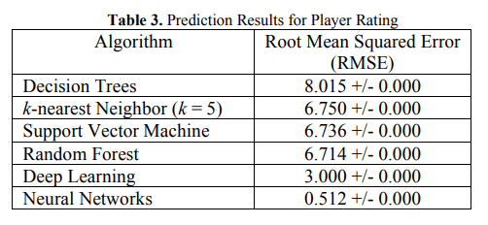
Player Rating Prediction
Prediction algorithms used:
Decision Trees
K-Nearest Neighbor
Support Vector Machine
Random Forest
Deep Learning
Neural Networks.

Slide 14
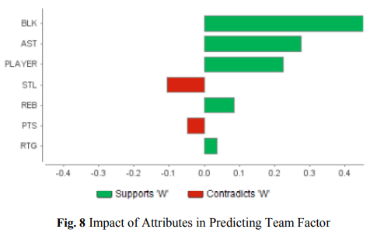
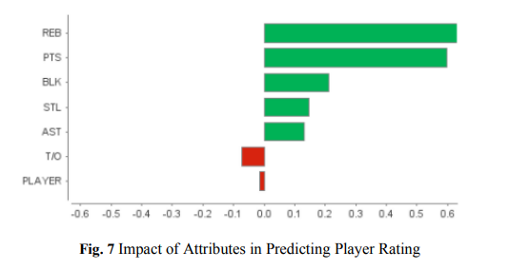
Attributes Affecting Player Rating and Team Factor

Slide 15
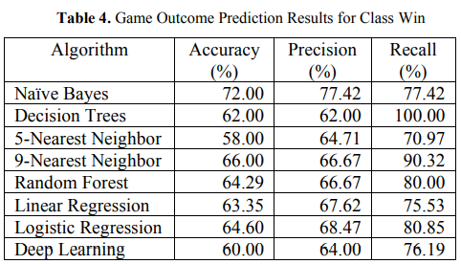
Game Outcome Prediction
Uses seven classification algorithms
Naïve Bayes shows highest accuracy.

Slide 16
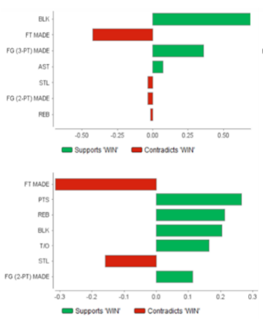
Naïve Bayes Algorithm
K-Means Algorithm

Slide 17
Conclusion
Various Machine Learning algorithms can be used to predict the game results.
Accuracy of the model depends on the characteristic of the analytic.
Coaches can make informed decisions not only in strategizing for the upcoming game but even while the game is still on.

Slide 18
Strategy of Implementation
Use NBA dataset from Kaggle to do analysis on player performance, predict player rating etc.
K-means algorithm for clustering and descriptive analytic.
Naïve Bayes for game outcome prediction.
Jupyter notebook or colab using libraries such as matplotlib, NumPy, pandas etc.

Slide 19
References
https://ieeexplore.ieee.org/document/9277009
https://en.wikipedia.org/wiki/K-means_clustering
https://en.wikipedia.org/wiki/Naive_Bayes_classifier

